Slide 1
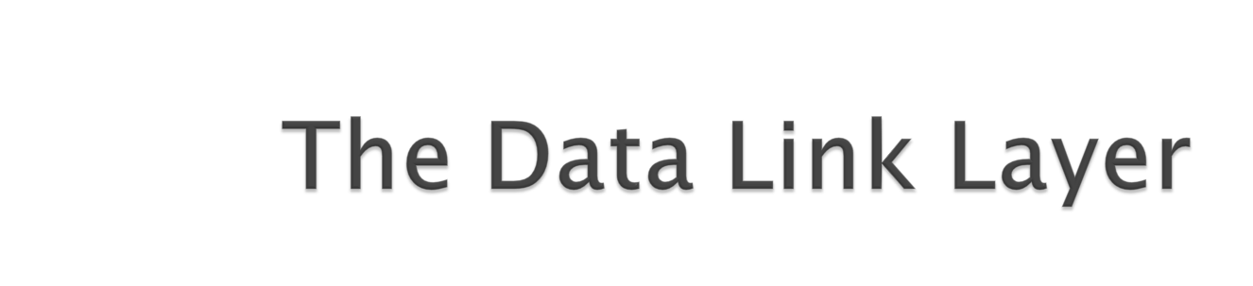

Slide 2

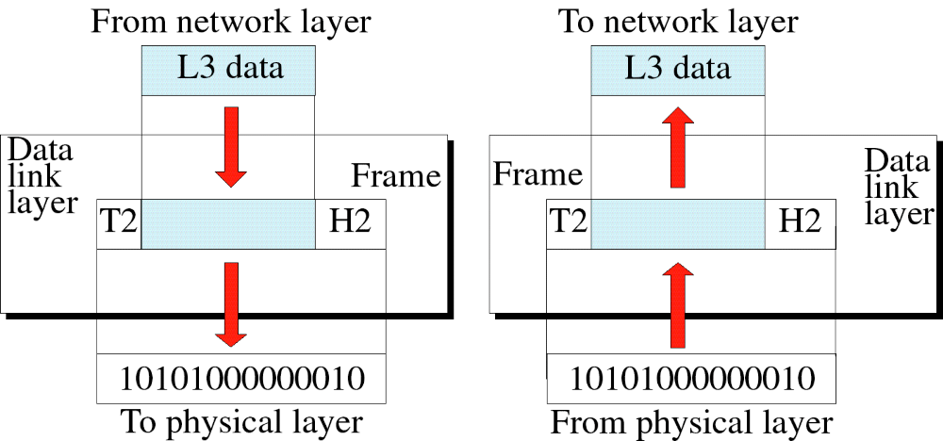
Data Link Layer : Services, Framing, Error Detection and Correction

Slide 3

Services Provided to the Network Layer
Framing
Error Control
Flow Control
Data Link Layer : Services, Framing, Error Detection and Correction

Slide 4

Provide service interface to the network layer
Dealing with transmission errors
Regulating data flow
  Slow receivers not swamped by fast senders
Data Link Layer : Services, Framing, Error Detection and Correction

Slide 5
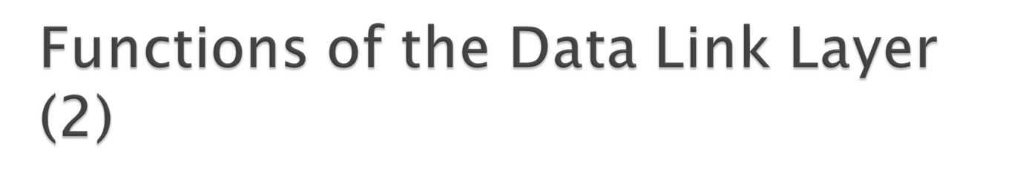
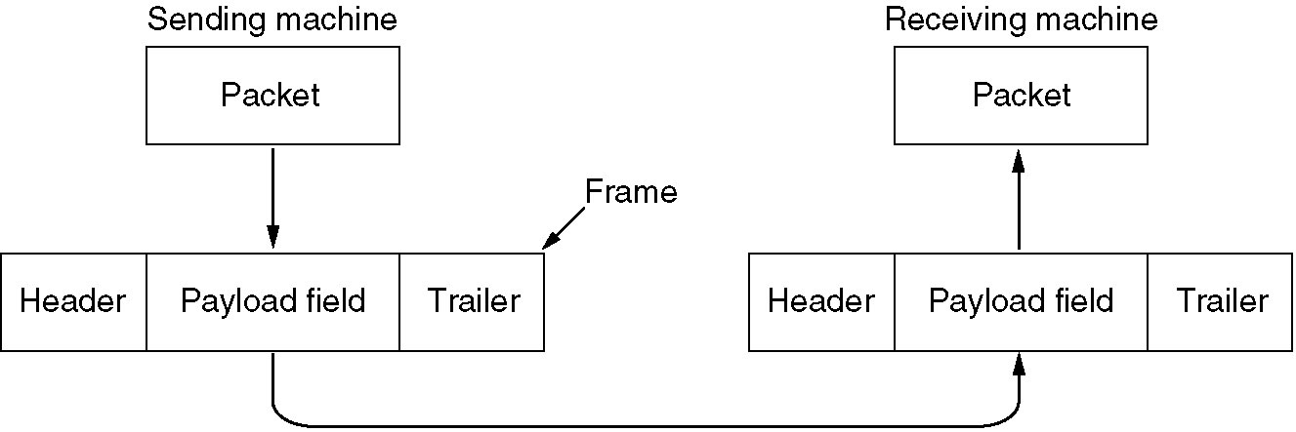
Relationship between packets and frames.
Data Link Layer : Services, Framing, Error Detection and Correction

Slide 6

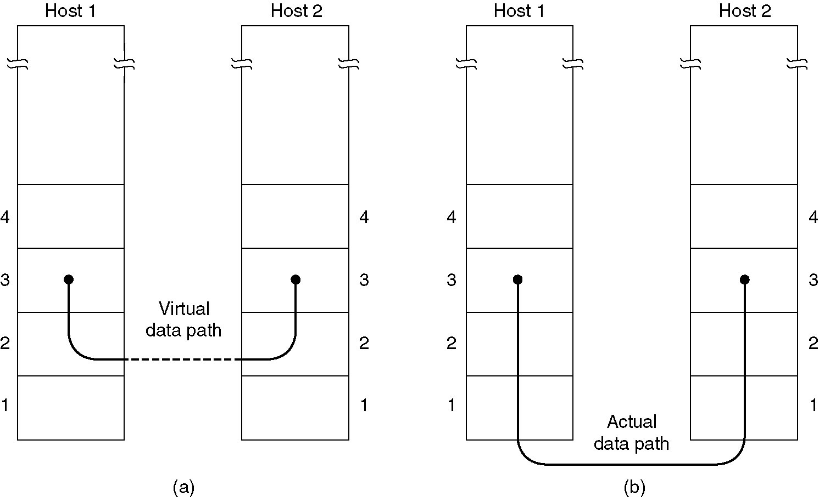
(a) Virtual communication.
(b) Actual communication.
Data Link Layer : Services, Framing, Error Detection and Correction

Slide 7

Unacknowledged connectionless service
Acknowledged connectionless service
Acknowledged connection-oriented service
Data Link Layer : Services, Framing, Error Detection and Correction

Slide 8
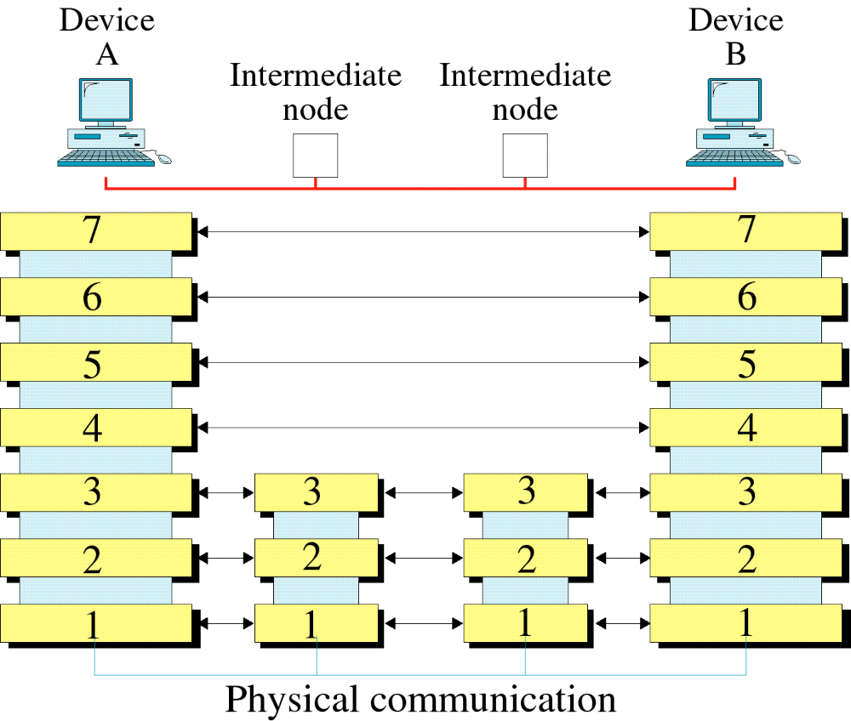
Data Link Layer : Services, Framing, Error Detection and Correction

Slide 9
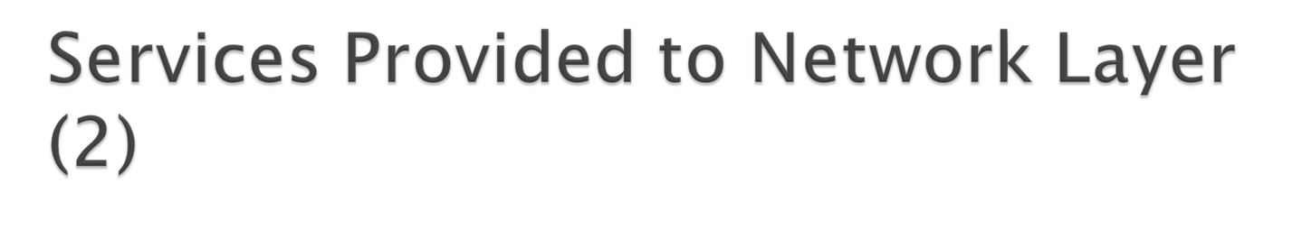
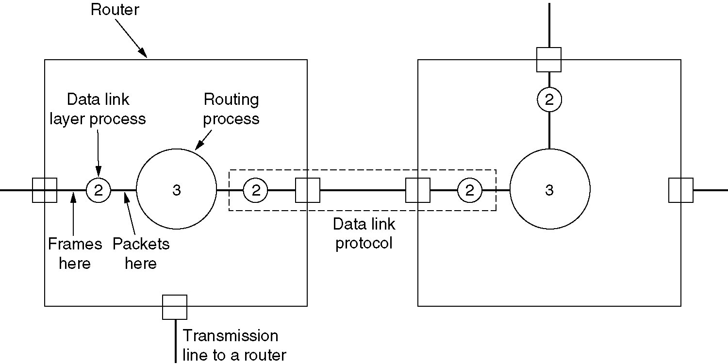
Placement of the data link protocol.
Data Link Layer : Services, Framing, Error Detection and Correction

Slide 10

Frames Are The Small data Units Created By Data Link Layer And The Process Of Creating Frames By The Data Link Layer Is Known As Framing.
The easiest way to achieve framing is to insert time gaps between frames.
Networks rarely make any guarantees about timing.
  Other Framing Methods are:
  1) Character count.
  2) Flag bytes with byte stuffing
  3) Starting and encoding flags, with bit stuffing
  4) Physical layer coding violations
Data Link Layer : Services, Framing, Error Detection and Correction

Slide 11

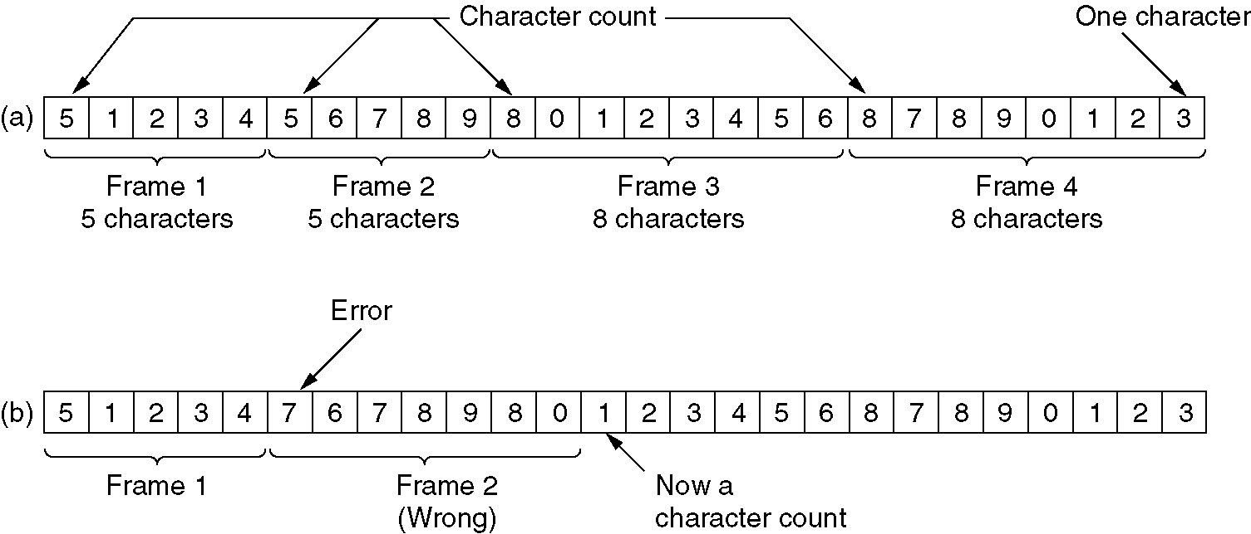
Character count framing method uses a field in the header to specify the number of characters in the frame.
A character stream. (a) Without errors.
(b) With one error.
Data Link Layer : Services, Framing, Error Detection and Correction

Slide 12

  The second method uses in each frame start and end special bytes (Flag byte) to get around the problem of resynchronisation after an error occurred.
  - Flag bytes used as a delimiters.
Data Link Layer : Services, Framing, Error Detection and Correction

Slide 13

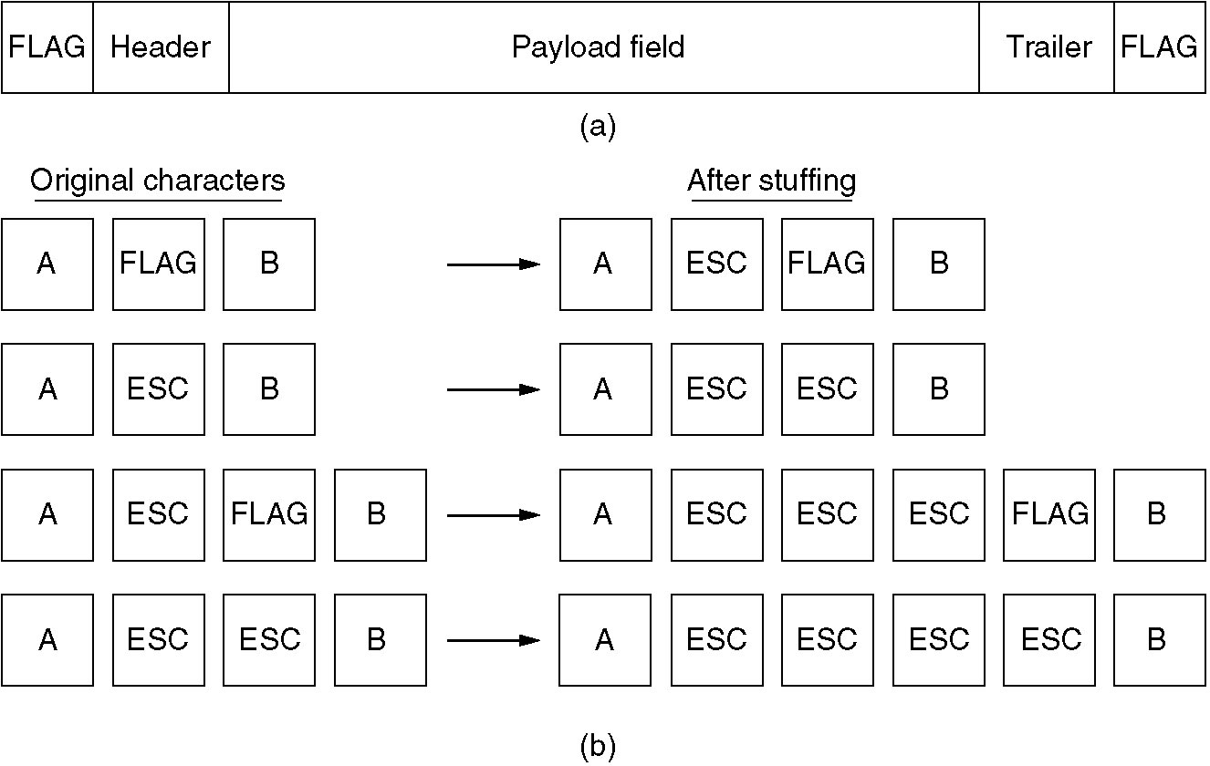
(a) A frame delimited by flag bytes.
(b) Four examples of byte sequences before and after stuffing.
Data Link Layer : Services, Framing, Error Detection and Correction

Slide 14

In this Method , Each Begins & Ends With a Special Bit pattern 01111110 Called Flags.
There for Each frame starts With 01111110& also Ends with 01111110.
The Main Problem arises in this Method When The Flag byte 01111110 Appear as data.
This Problem Is Handled By technique called Bit stuffing That Is similar To character stuffing.
Data Link Layer : Services, Framing, Error Detection and Correction

Slide 15
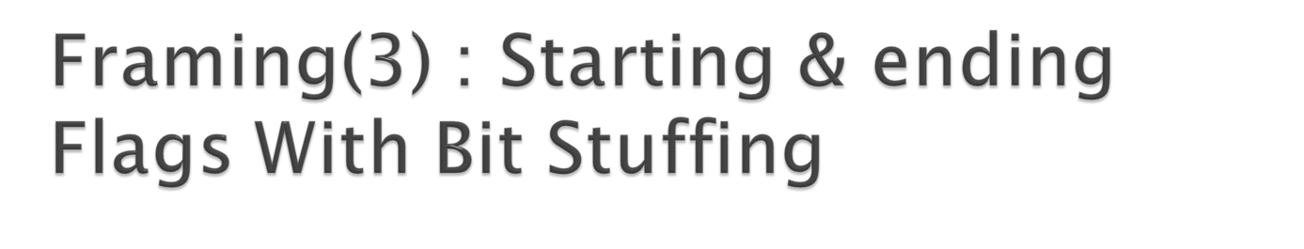
Stuffing Performed By Data Link layer
01111110
0
1
0
1
0
0
1
1
1
1
1
0
1
0
1
01111110
Ending Flag BIT
Shifted Bit
Starting flag Bit
0
1
0
1
0
0
1
1
1
1
1
1
0
1
0
1
Data received by Network layer On reciever side After Performing Destuffing By data link Layer
BIT stuffing
Data Link Layer : Services, Framing, Error Detection and Correction

Slide 16
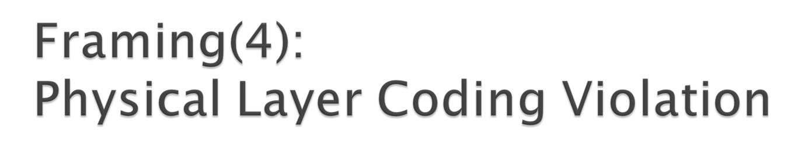
This Framing Method Is Used only In those network In which Encoding On The Physical Medium Contain some Redundancy.
Some LANs Encode Each Bit Of Data By using two Physical Bit.
(Menchester coding is Used)
In this method Bit 1 Is encoded into high-low(10) Pair And Bit 0 Is Encoded Into low-high(01)pair shown in figure.
Data Link Layer : Services, Framing, Error Detection and Correction

Slide 17

0
1
0
1
1
0
Menchester Encoding
Data Link Layer : Services, Framing, Error Detection and Correction

Slide 18

A bit String,0111101111101111110, needs to be transmitted at the data link layer. What is the string actually transmitted after bit stuffing?
Data Link Layer : Services, Framing, Error Detection and Correction

Slide 19

The following character encoding is used in a data link protocol:
A : 01000111 B : 11100011 FLAG: 01111110 ESC: 11100000
show the bit sequence transmitted (in binary) for the four character frame : A B ESC FLAG when each of the following framing methods are used:
a) character count
b) Flag bytes with byte stuffing
c) Starting and ending flag bytes, with bit stuffing
Data Link Layer : Services, Framing, Error Detection and Correction

Slide 20

The following data fragment occurs in the middle of a data stream for which the byte stuffing algorithm described in the text is used :
A B ESC C ESC FLAG FLAG D
Data Link Layer : Services, Framing, Error Detection and Correction

Slide 21

When data is transmitted over a cable or a channel , there is always a chance that some of the bits will be changed (corrupted) due to noise, signal distortion or attenuation.
If errors do occur, then some of the transmitted bits will either change from 0 to 1 or from 1 to 0.
Data Link Layer : Services, Framing, Error Detection and Correction

Slide 22

Enough redundancy is added to detect an error.
The receiver knows an error occurred but does not know which bit(s) is(are) in error.
Has less overhead than error correction
Error Detection Methods :
LRC
VRC
CRC
Checksum
Data Link Layer : Services, Framing, Error Detection and Correction

Slide 23
The message 11001001 is to be transmitted using the CRC polynomial x³ + 1 to protect it from errors. The message that should be transmitted is: (GATE 2007)
(A) 11001001000
(B) 11001001011
(C) 11001010
(D) 110010010011
Data Link Layer : Services, Framing, Error Detection and Correction

Slide 24

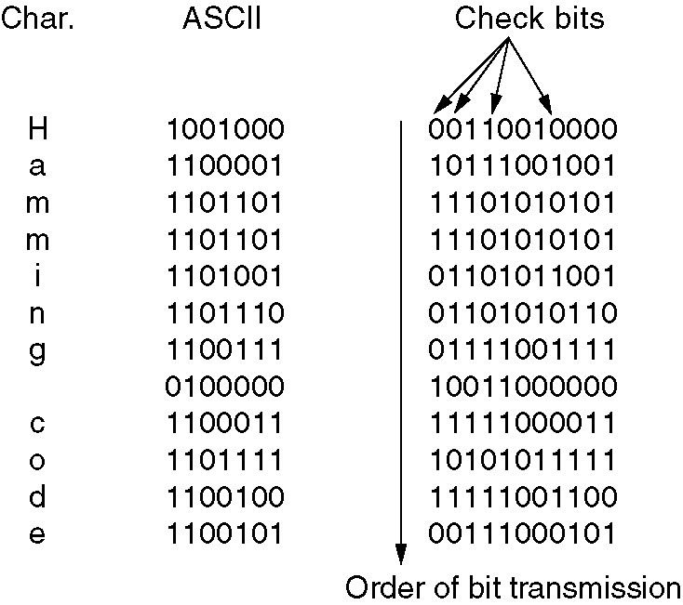
Use of a Hamming code to correct burst errors.
Data Link Layer : Services, Framing, Error Detection and Correction

